Slide 1
CSS
TechKids | C4E | Web module

Slide 2
Why does your website desperately need CSS?

Slide 4
Just kidding :D

Slide 5

Youtube without CSS

Slide 6
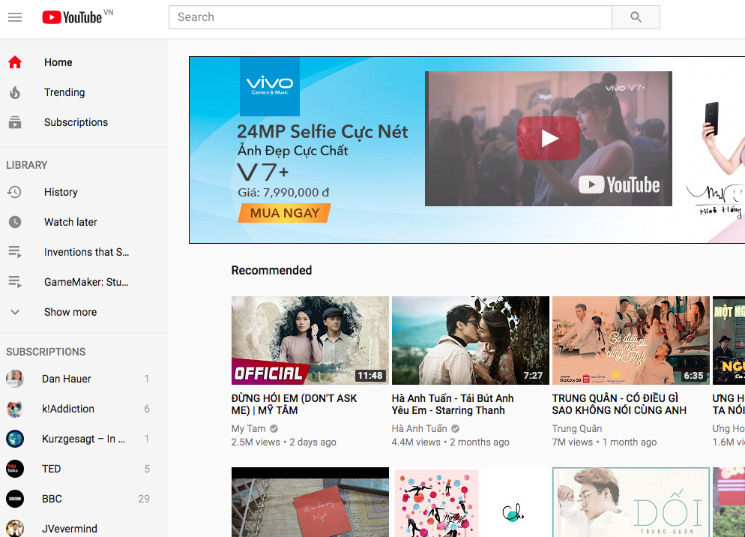
Youtube with CSS

Slide 7
Agenda
CSS Intro
CSS How To
CSS Syntax
CSS Properties

Slide 8
CSS

Slide 9
Selector

Slide 10
Element selector
Selector
Value
h1{color: red;}
Property

Slide 11
ID selector
Selector
Value
#first-heading {color: red;}
Attribute

Slide 12
Class selector
Selector
Value
.text-red {color: red;}
Attribute

Slide 13

CSS Properties: Text & Font
h1 {
text-align: left;
font-family: Irvin Heading;
font-size: 40px;
}

Slide 14

CSS Properties: Background

Slide 15
CSS Properties: Background
div {
background-image: url(‘...’);
background-size: cover;
background-attachment: fixed;
}

Slide 16
CSS Properties: Layout
div {
width: 30%;
height: 60%;
display: inline-block;
}
div {
width: 30%;
height: 60%;
display: inline-block;
}
height: 300px;
width: 800px;

Slide 17
CSS Properties: Box Model
margin: 20px;
border: 5px solid brown;
padding: 30px;
content

Slide 18
CSS Properties: Flex Box
div {
display: flex;
flex-flow: row wrap;
}
1
2
3
4
5
6

Slide 19
CSS Properties: Flex Box
1
2
3
4
5
6
7
div {
display: flex;
flex-flow: row nowrap;
}

Slide 20
CSS Properties: Flex Box
div {
display: flex;
justify-content: center;
}
1
2
3
div {
display: flex;
justify-content: space-between;
}
1
2
3
div {
display: flex;
justify-content: space-around;
}
1
2
3

Slide 21
CSS Properties: Flex Box
1
2
3
4
div {
display: flex;
align-items: center;
}
5

Slide 22
CSS Properties: Flex Box
1
2
3
div {
display: flex;
align-content: space-between;
}
4

Slide 23
Q & A

